Slide 1
The Theory of Constraints
Applying Theory to Software

Slide 2
Agenda
What Is Constraint Theory?
The Five Focusing Steps
Constraint Theory Applied
Manufacturing
Software Construction
Data Processing
Sources and Discussion

Slide 3
What Is Constraint Theory?
The throughput of a system is constrained by one (or very few) “constraints” – ie, bottlenecks.
From The Phoenix Project:
...any improvements made anywhere besides the bottleneck are an illusion. Astonishing but true! Any improvement made after the bottleneck is useless, because it will always remain starved, waiting for work from the bottleneck. And any improvements made before the bottleneck merely results in more inventory piling up at the bottleneck.

Slide 4
The Five Focusing Steps
Identify the Constraint – What’s the “weak link in the chain”?
Exploit the Constraint – Keep it running and well-fed with the highest-priority work
Subordinate Everything to the Constraint – Offload work; ensure quality of inputs; don’t rock its boat
Elevate the Constraint – Spend money to speed-up the constraint with staff, tools, infrastructure
Avoid Inertia – If it’s no longer the constraint (IOW, you’ve “broken the constraint”) go back to Step 1

Slide 5
Constraint Theory Applied - Manufacturing
Identify the Constraint – Which station has the biggest pile of subassemblies waiting for it?
Exploit the Constraint – Limit, prioritize work (materiel, sales) into plant to the constraint
Subordinate Everything to the Constraint
Inspection station in front of constraint
Can another station do some of that work?
Elevate the Constraint – More staff, shifts at constraint station; install another copy
Avoid Inertia – After every improvement, see if that station is still the constraint

Slide 6
Constraint Theory Applied - Software Construction
Identify the Constraint – Which team/person are you always waiting on?
Exploit the Constraint – Keep and prioritize a backlog for that team/person; tag work dependent on them
Subordinate Everything to the Constraint
Communicate clearly to avoid delays clarifying the ask
Can someone else do this?
Elevate the Constraint – Train or hire people to grow the constraint’s velocity
Avoid Inertia – Periodically ask yourselves if that team/person is still the constraint

Slide 7
Constraint Theory Applied - Data Processing
Identify the Constraint – Growing lag; highest %age of total cycle time; VM with worst CPU usage
Exploit the Constraint – Durable queue ahead of constraint; throttle upstream to constraint (or queue)
Subordinate Everything to the Constraint – Offload work; validate inputs; compartmentalize deploys
Elevate the Constraint – Scale constraint up or out; switch to idempotency for unit-level load balancing
Avoid Inertia – Look at data after every improvement to see if something else is now the constraint

Slide 8
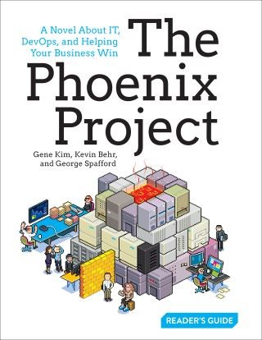
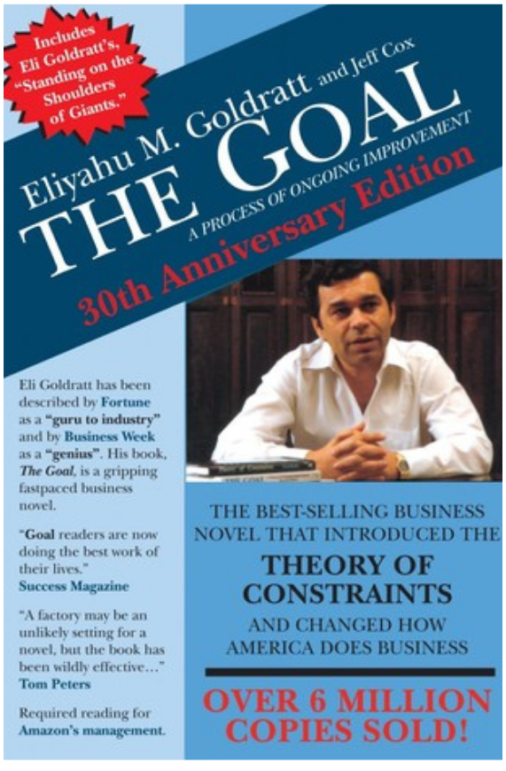
Sources and Discussion
The Phoenix Project – Novel by Kim, Behr, and others covering Constraint Theory in software
Theory of Constraints – The Goal – Article on Medium by Tom Connor
Everything You Need to Know About the Theory of Constraints – Article on Smartsheet by Kate Eby
The Goal – Seminal novel by Eliyahu Goldratt

